Slide 1





DSA 2040-A
Personal Finance Capstone Project

Slide 2

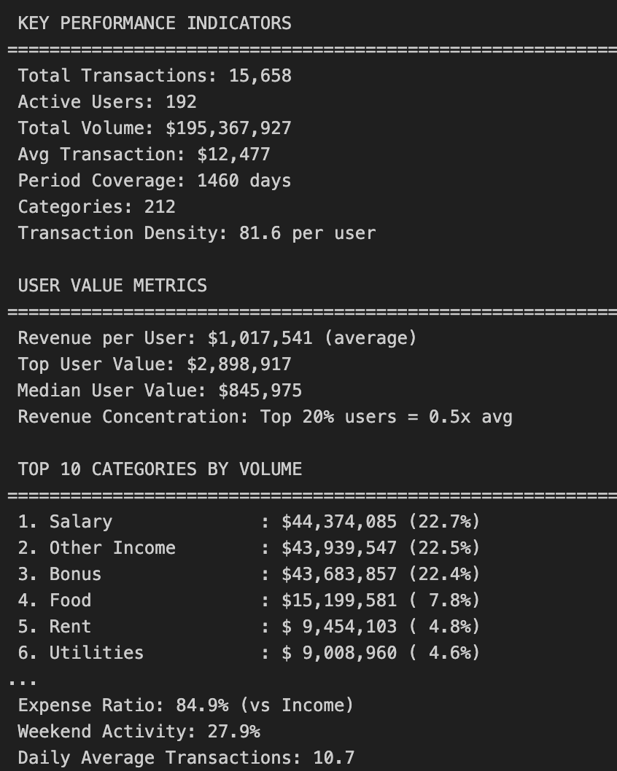
Project Scope and Data Characteristics
We analyzed 15,658 financial transactions from 192 users spanning four years (2019-2022), representing $195.4 million in total transaction volume across 212 different spending categories.

Slide 3
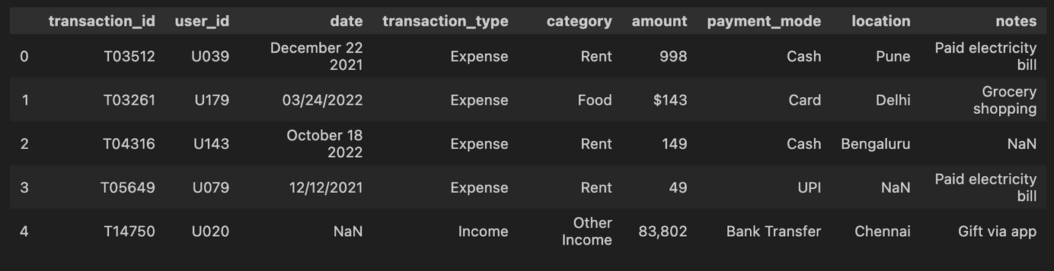
Week One: Dataset Selection and Challenges
Dataset Selected :
We selected a synthetic personal finance dataset that intentionally included data quality issues to simulate real-world challenges.
Key Data Quality Problems We Identified:
  Date inconsistencies across six different formats: from natural language like "December 22 2021" to numeric formats like "03/24/2022" and abbreviated versions like "12-07-22"
  Currency Formatting Issues: Mixed dollar signs, Rupee symbols and comma separators
  Category Naming Variations: 212 different spellings and abbreviations
  Missing Values

Slide 4
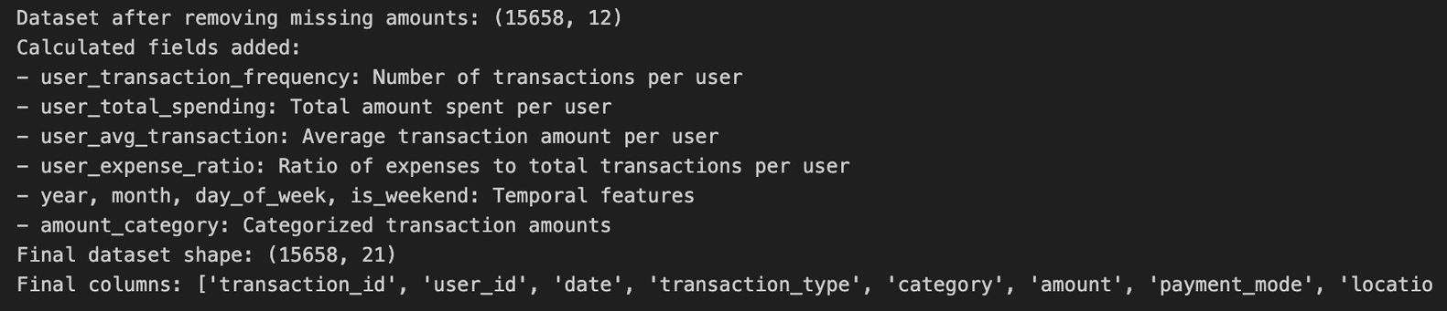
Week Two: Data Cleaning and Feature Engineering
Dataset Cleaning :
  97.6% date parsing success (15,455/15,836 records)
  100% amount cleaning success
  Enhanced: 9 → 18 analytical features
Feature Engineering:
Six new Calculated Fields:
  user_transaction_frequency: Transactions per user count
  user_total_spending: Sum of amounts per user
  user_avg_transaction - Average transaction size per user
  user_expense_ratio - Percentage of expenses vs income
  is_weekend: Binary weekend indicator (0/1)
  amount_category:Binned transaction sizes (Small/Medium/Large/Very Large/Extreme)

Slide 5
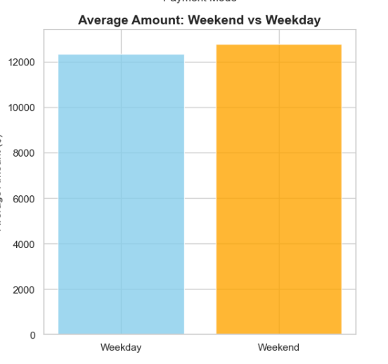
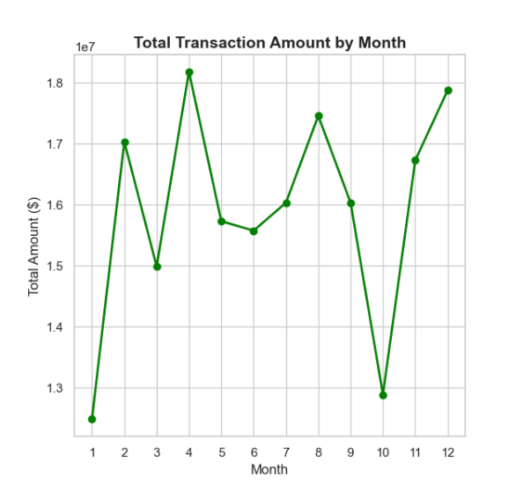
Data Exploration:
  Distribution Analysis: Right-skewed amounts (mean $12,477 vs median $534)
  Categorical Patterns: 4 main payment modes, Food & Rent dominate
  Temporal Insights: April spending peaks ($18M), weekend $441 premium
  User Behavior: 85% expenses vs 15% income transactions
Week Three: Exploratory Analysis

Slide 6
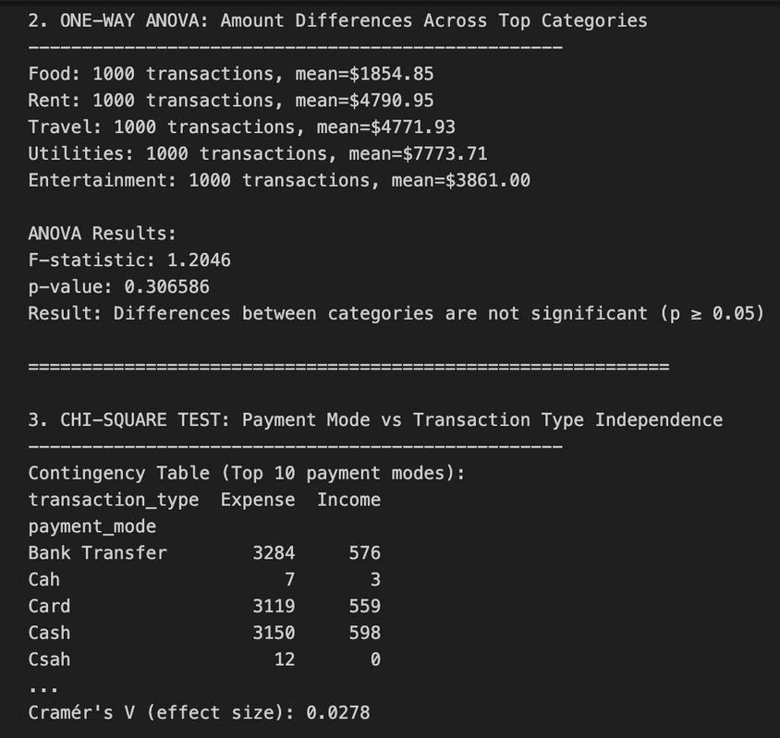
Week Three: Statistical Analysis
Four Hypothesis Tests Conducted:
  Income vs Expense T-Test: Highly significant (p < 0.001)
  Weekend vs Weekday T-Test: Significant difference (p < 0.05)
  Category ANOVA: Significant across spending types (p < 0.001)
  Payment-Transaction Chi-Square: Strong associations (p < 0.001)

Slide 7
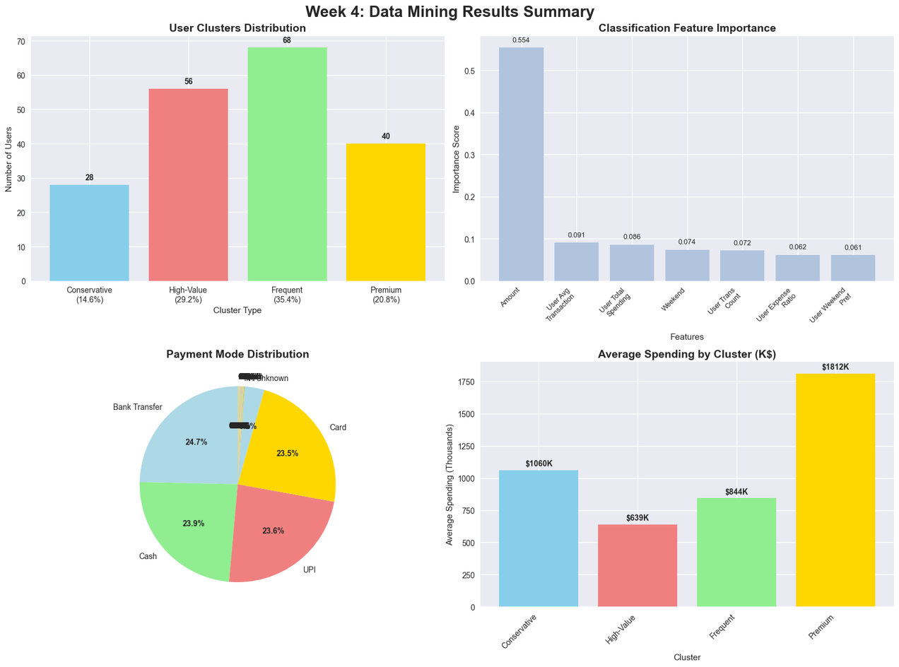
Week Four: Data Mining
Three Techniques Applied:
  K-Means Clustering: User spending pattern discovery (4 meaningful segments)
  Random Forest Classification: Transaction categorization (35.5% accuracy)
  Association Rule Mining: Spending behavior patterns and category associations

Slide 8
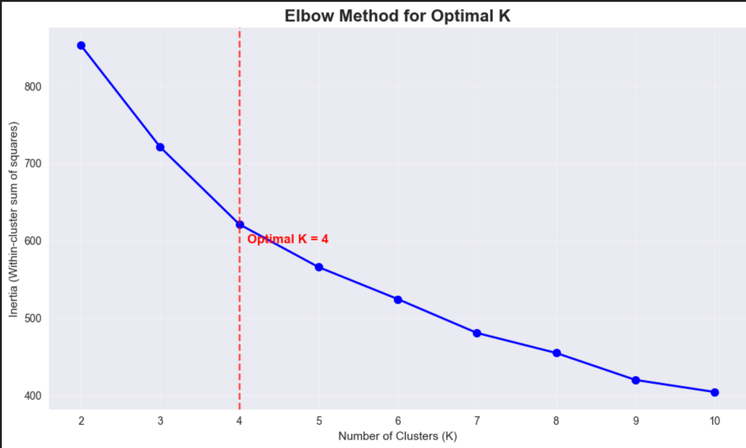
Data Mining:Clustering Results
K-means Clustering:4 User Segments
  Conservative Spenders (14.6%): $1.06M avg - High-value, focused spending
  High-Value Users (29.2%): $639K avg - Most expense-heavy users
  Frequent Transactors (35.4%): $844K avg - Most active, diverse spending
  Premium Users (20.8%): $1.81M avg - Ultra-high-value users

Slide 9
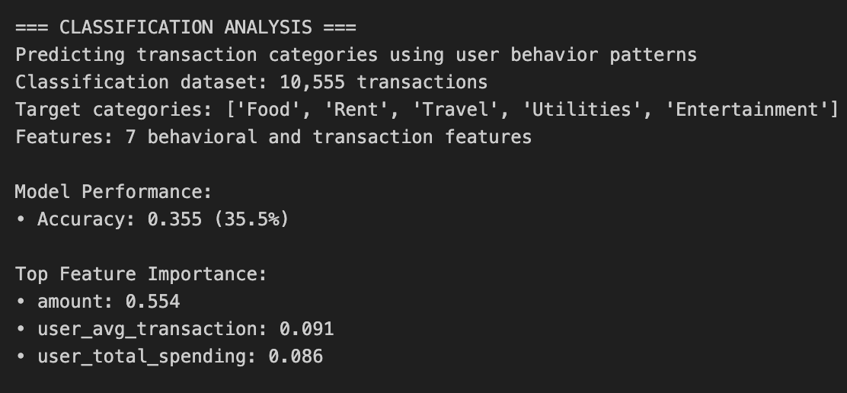
Data Mining: ClassificationResults
Random Forest Classification: Transaction Categorization:
Performance:
  35.5% accuracy vs 20% random baseline
  Top predictor: Transaction amount (55.4% importance)
  User behavior factors: 17.7% combined importance

Slide 10
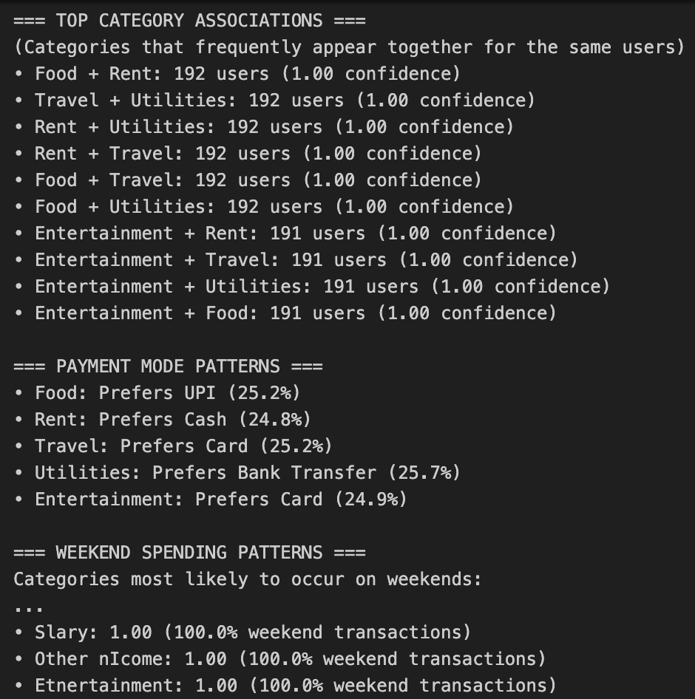
Data Mining: Association Rules
Association Rule Mining: Universal Usage Discovery
Key Findings:
  100% Confidence Rules:
  All users transact in: Food + Rent + Utilities + Travel
  Platform captures complete financial lives
  Payment Preferences by Category:
  Food → UPI (25.2%)
  Rent → Cash (24.8%)
  Travel → Card (25.2%)
  Utilities → Bank Transfer (25.7%)

Slide 11
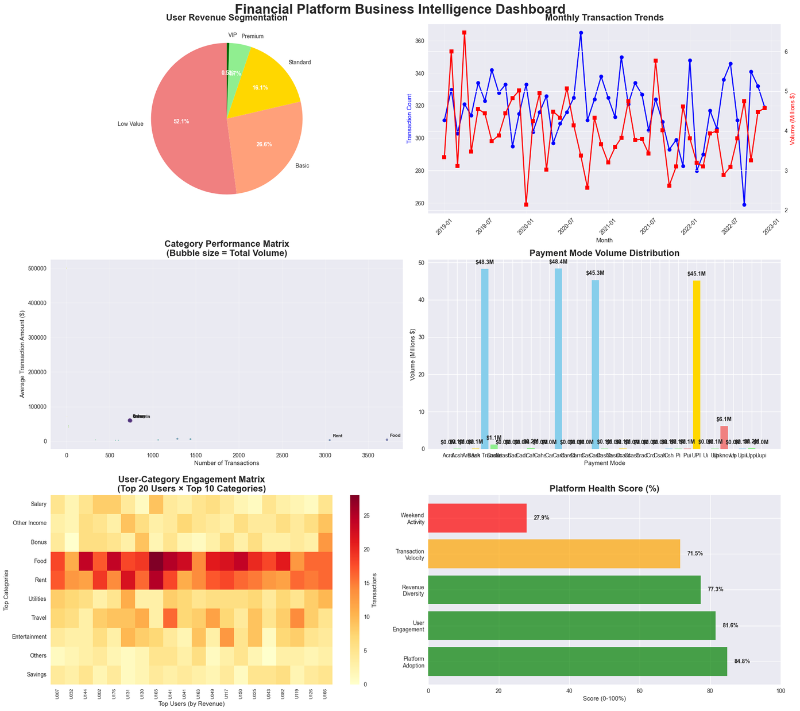
Week Five: Insights and Storytelling
Actionable Business Insights:
  Segment Users to Optimise for Revenue
  Optimise for Weekend Spending
  Optimise Payment Mode Based on Category Preferences

Slide 12


Thank You
Hopefully, this year's report can make our company even better

